Slide 1
INDUSTRIAL TRAINING ON MACHINE LEARNING
SUDIPTA HALDER
ARDENT computech PVT. LTD.
COMPUTER SCIENCE AND ENGINEERING
UNIV ROLL NO - 10400116059

Slide 2
CONTENTS
ACKNOWLEGEMENT
INTRODUCTION
ALGORITHMS
APPLICATIONS
PROJECT
CONCLUSION

Slide 3
ACKNOWLEGEMENT
I would like to express my special thanks of gratitude to my Rafiqul Mallick as well as Ardent Computech Pvt. Ltd. which gave me the golden opportunity to learn Machine Learning using Python and to do this wonderful project , which also helped me in doing a lot of Research and I came to know about so many new things I am really thankful to them.
- Sudipta Halder

Slide 4
INTRODUCTION
Machine learning is an application of artificial intelligence (AI) that provides systems the ability to automatically learn and improve from experience without being explicitly programmed. Machine learning focuses on the development of computer programs that can access data and use it learn for themselves.
The process of learning begins with observations or data, such as examples, direct experience, or instruction, in order to look for patterns in data and make better decisions in the future based on the examples that we provide. The primary aim is to allow the computers learn automatically without human intervention or assistance and adjust actions accordingly.
Testing
Input Samples
Learning Method
System
Training

Slide 5
ALGORIHMS
The success of machine learning system also depends on the algorithms.
The algorithms control the search to find and build the knowledge structures.
The learning algorithms should extract useful information from training examples
The main four categories of machine Learning Algorithms are-
• Supervised Learning
• Unsupervised Learning
• Semi-Supervised Learning
• Reinforcement Learning

Slide 6
Supervised machine learning algorithms can apply what has been learned in the past to new data using labelled examples to predict future events. Starting from the analysis of a known training dataset, the learning algorithm produces an inferred function to make predictions about the output values. The system is able to provide targets for any new input after sufficient training. The learning algorithm can also compare its output with the correct, intended output and find errors in order to modify the model accordingly.
In contrast, unsupervised machine learning algorithms are used when the information used to train is neither classified nor labelled. Unsupervised learning studies how systems can infer a function to describe a hidden structure from unlabelled data. The system doesn’t figure out the right output, but it explores the data and can draw inferences from datasets to describe hidden structures from unlabelled data.
Semi-supervised machine learning algorithms fall somewhere in between supervised and unsupervised learning, since they use both labelled and unlabelled data for training – typically a small amount of labelled data and a large amount of unlabelled data. The systems that use this method are able to considerably improve learning accuracy. Usually, semi-supervised learning is chosen when the acquired labelled data requires skilled and relevant resources in order to train it / learn from it. Otherwise, acquiring unlabelled data generally doesn’t require additional resources.
Reinforcement machine learning algorithms is a learning method that interacts with its environment by producing actions and discovers errors or rewards. Trial and error search and delayed reward are the most relevant characteristics of reinforcement learning. This method allows machines and software agents to automatically determine the ideal behaviour within a specific context in order to maximize its performance. Simple reward feedback is required for the agent to learn which action is best; this is known as the reinforcement signal.

Slide 7
Here is the list of commonly used machine learning algorithms. These algorithms can be applied to almost any data problem:
Linear Regression
Logistic Regression
Decision Tree
SVM
Naive Bayes
KNN
K-Means
Random Forest
Linear Regression: It is used to estimate real values (cost of houses, number of calls, total sales etc.) based on continuous variable(s). Here, we establish relationship between independent and dependent variables by fitting a best line. This best fit line is known as regression line and represented by a linear equation Y= a *X + b.
Logistic Regression: It is used to estimate discrete values ( Binary values like 0/1, yes/no, true/false ) based on given set of independent variable(s). In simple words, it predicts the probability of occurrence of an event by fitting data to a logit function. Hence, it is also known as logit regression. Since, it predicts the probability, its output values lies between 0 and 1 (as expected).
Decision Tree: It is a type of supervised learning algorithm that is mostly used for classification problems. This is done based on most significant attributes/ independent variables to make as distinct groups as possible.
KNN (k- Nearest Neighbours):K nearest neighbours is a simple algorithm that stores all available cases and classifies new cases by a majority vote of its k neighbours. The case being assigned to the class is most common amongst its K nearest neighbours measured by a distance function.

Slide 8
APPLICATIONS
Virtual Personal Assistants :- Siri, Alexa, Google Now are some of the popular examples of virtual personal assistants. As the name suggests, they assist in finding information, when asked over voice.
Email Spam and Malware Filtering:-There are a number of spam filtering approaches that email clients use. To ascertain that these spam filters are continuously updated, they are powered by machine learning.
Online Fraud Detection:-Machine learning is proving its potential to make cyberspace a secure place and tracking monetary frauds online is one of its examples. For example: Paypal is using ML for protection against money laundering.
Image Recognition:-Image recognition is one of the most common uses of machine learning. There are many situations where you can classify the object as a digital image. Machine learning can be used for face detection in an image as well.
Medical diagnosis:-Machine learning can be used in the techniques and tools that can help in the diagnosis of diseases. It is used for the analysis of the clinical parameters and their combination for the prognosis example prediction of disease progression for the extraction of medical knowledge for the outcome research, for therapy planning and patient monitoring.

Slide 9
PROJECT
Topic:- Predicting Loan application status
Requirements:
Python 3.5 +
Scikit-Learn (latest version)
Numpy, Matplotlib.
Kaggle Dataset
Description: The loan is one of the most important products of the banking. All the banks are trying to figure out effective business strategies to persuade customers to apply their loans. However, there are some customers behave negatively after their application are approved. To prevent this situation, banks have to find some methods to predict customers’ behaviours. Machine learning algorithms have a pretty good performance on this purpose, which are widely-used by the banking. Here, I will work on loan behaviours prediction using machine learning models.

Slide 10
OBJECTIVE
PROBLEM: We have the loan application information like applicant’s name ,personal details, financial information and requested loan amount and related details and the outcome(whether the application approved or rejected).Based on this we are going to train a model and predict if a loan will get approved or not.
OBJECTIVE:
Our objective from the project is to make use of pandas, matplotlib and seaborn libraries from python to extract insights from the data and scikit learn libraries for machine Learning.
Secondly, to learn how to hypertune the parameters using grid search cross validation for the machine learning model.
In the end to predict whether the loan applicant can replay the loan or not using voting ensembling techniques of combining the predictions from multiple machine learning algorithms.

Slide 11
PLANNING: The first thing we need to do and before jumping to analyse the data is to understand the problem statement and create a objective. The next step is to identify our independent and dependent variables.
Now its time to make the next big step in our analysis which is splitting the data into training and test sets.
A training set is the subset of the data that we use to train our models but the test set is a random subset of the data which are derived from the training set. We will use the test set to validate our models as un-forseen data.
In a sparse data like ours, it is easy to overfit the data. Therefore we are going to score the data using our test set. Once we split the data, we will treat the testing set like it no longer exists.

Slide 12
PROJECT SCOPE :
Loan defaults will cause huge loss for the banks, so they pay much attention on this issue and apply various method to detect and predict default behaviours of their customers.
All the banks are trying to figure out effective business strategies to persuade customers to apply their loans.
To prevent this situation, banks have to use many methods to predict their customers behaviours. Machine Learning algorithms have a pretty good performance on this purpose.

Slide 13
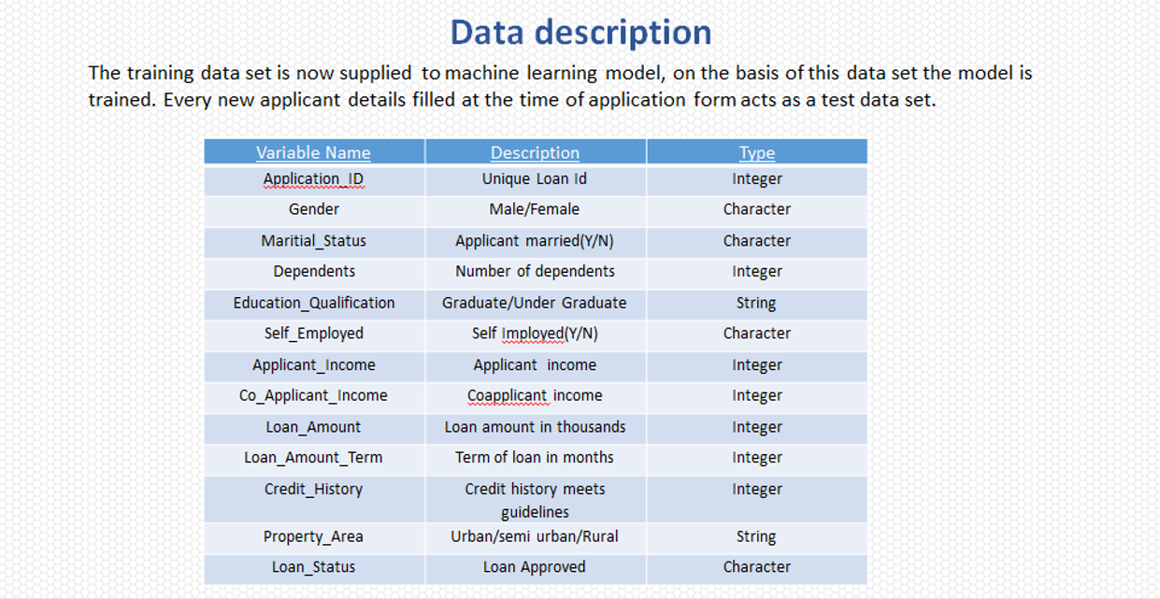
DATA DESCRIPTION:
The training data set is now supplied to machine learning model, on the basis of this dataset model is trained. Every new applicant’s details filled at the time of the application form acts as a test data set.

Slide 14
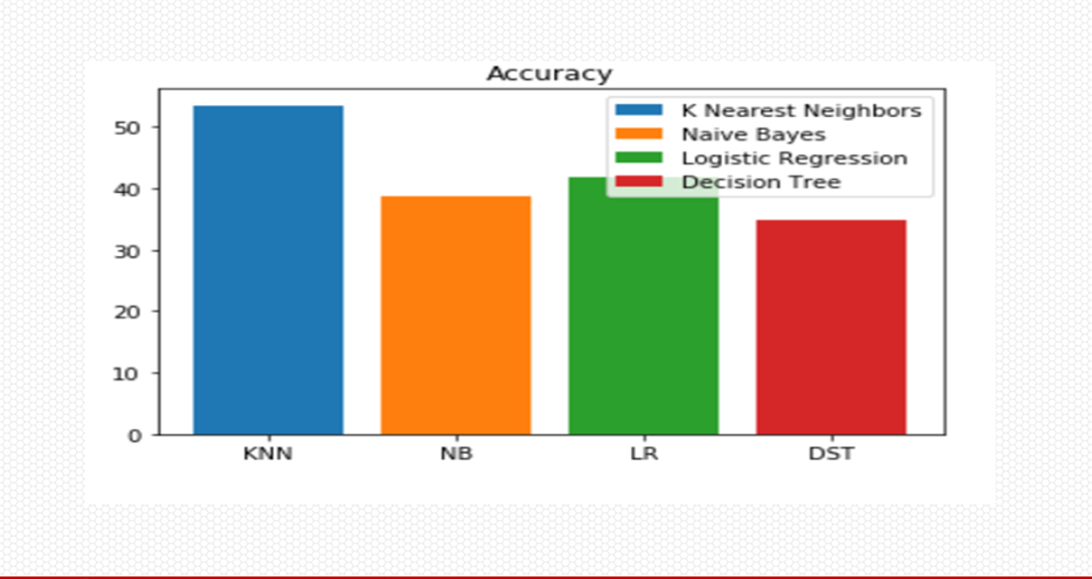
ACCURACY:
FUTURE SCOPE:
Time series analysis can be done using the Loan data for several years,for prediction of the approximate time, when the client can default.
Future analysis can be done on predicting the approximate interest rates that the loan applicant is expected to get as per his profile if his loan is approaved.

Slide 15
CONCLUSION:-
I completed my training by completing this project. I declare that the above mentioned report is mine and all data and thing are of my resource and study. The training was really helpful. I learned a lot of things throughout the course .I got motivated to work more in future based on Machine Learning related things.

Slide 16


